Slide 1

Estimating when Three natural resources will be depleted
Capstone 3 – Springboard Data Science Track
By: Yvonne Quiachon, CPhT
Cleveland State University: Bachelor of Science in Biomedical Technology

Slide 2
Slideshow Timeline
Context
Data Acquisition
EDA: Coal
EDA: Oil
EDA: Natural Gas
Synthetic Control: Coal
Synthetic Control: Oil
Synthetic Control: Natural Gas
Well Log Analysis
Classification Models
Regression models
Max Drawdown: Oil
Model selection
Answering Questions
Assumptions & Limitations

Slide 3
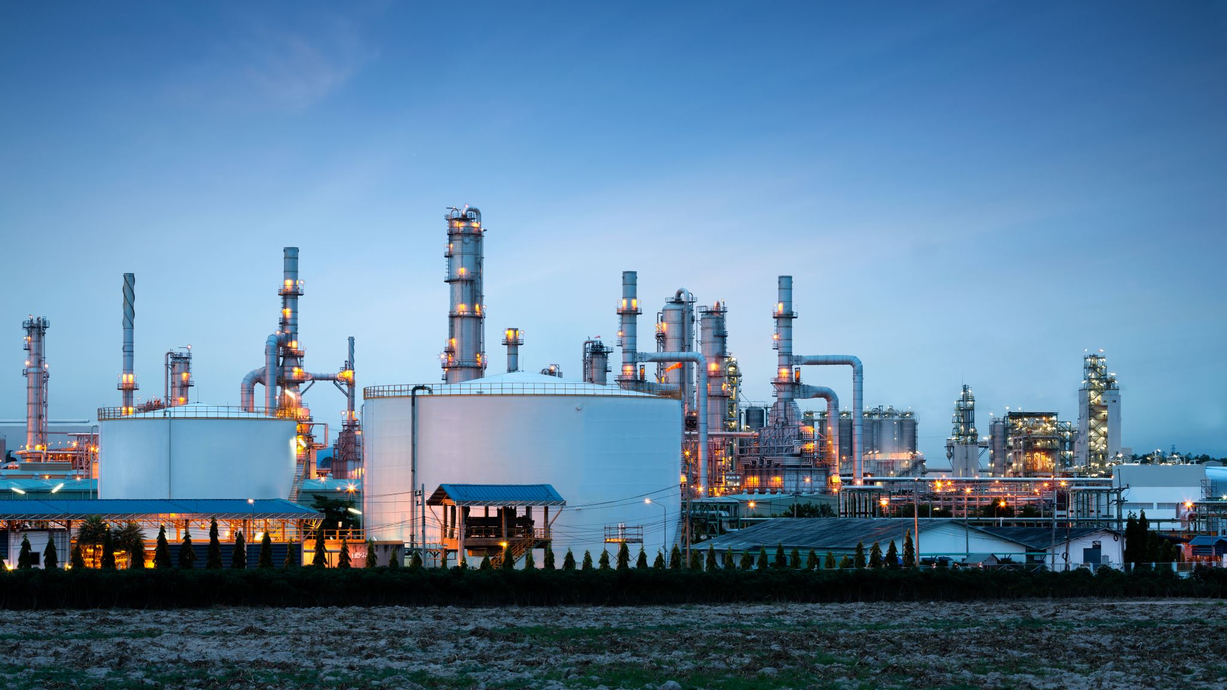
Context
Problems:
What possible effects (direct or indirect) does industrialization, modernization, and manufacturing have on the availability and distribution of coal, oil, and natural gas?
If and when will these resources be depleted?

Slide 4
Data Acquisition
Sources:
Global Power Plant Database - Datasets - Data | World Resources Institute (wri.org)
https://data.un.org/
Downloads | Energy economics | Home (bp.com)
Notes:
List of main sources: 1st – open source database of power plants around the world (data for coal, oil, gas) 2nd – world population data analysis 3rd – Statistical Review of World Energy; data for proven reserves, energy production, and consumption.

Slide 5
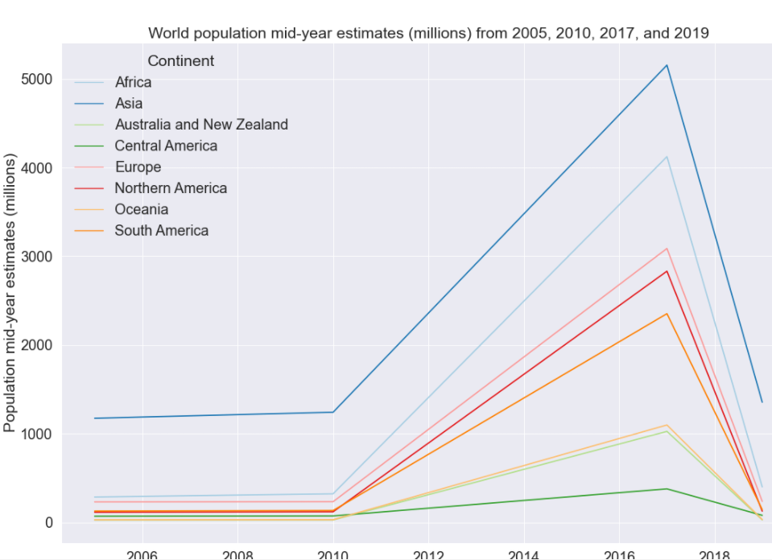
World-population mid-year estimates (millions) from 2005,201, 2017, and 2019
https://data.un.org/
Notes:
Peak around 2017, then sharp decline by 2019. Same for all regions.

Slide 6
Coal
Facts:
Cheap resource.
Surface mining or underground mining.
Provides steam and power needed to mass-produce items, generate electricity, generate heat, fuel steamships, fuel steel industry.
Emits CO2, SO2 (in U.S. generates 42% mercury emissions and 2/3 SO2 – contributing to acid rain and particulate matter).

Slide 7
EDA: Coal
Gwh for 2017
Top 6 Countries w/ highest est. gen. gwh for 2017: Taiwan, South Korea, South Africa, Malaysia, Israel, Mexico
Coal Reserves
Top 5 countries w/ most coal reserves: US, Russian Federation, Australia, China
Coal Production
China held top coal producer for 27 years. US is second.
Coal Consumption
China is 1st place, US 2nd place.
Notes:
Gwh: measure how much electricity do coal plants for each country generate? These are the countries with highest coal-fired generation of electricity.

Slide 8
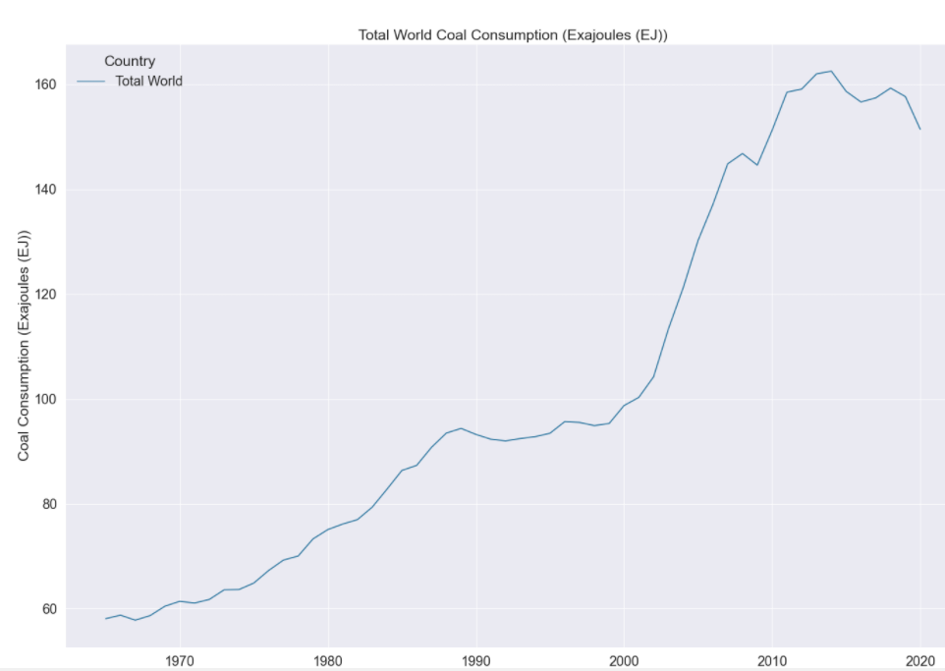
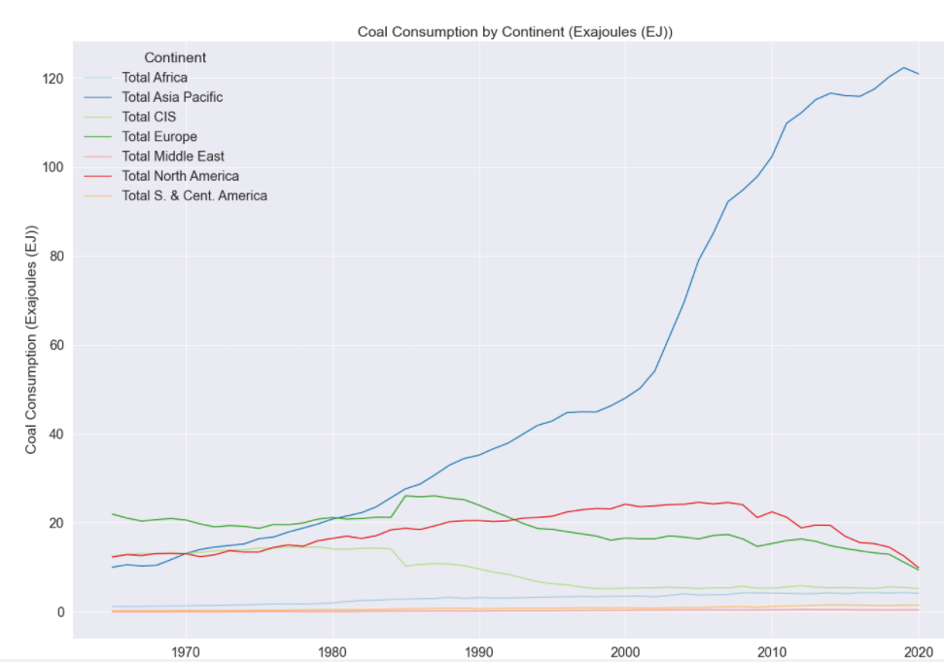
Coal Consumption: Total World and by Region
Notes:
Talk about units used. The total world and Total Asia Pacific trend is similar; there may be a dominating country for coal consumption. There is a sharp increase in 2003 for total world and total Asia Pacific, while other regions are relatively flat line. For North America and Europe, coal consumption by 2012 is going down. In 1985, when there is an increase in coal consumption for Europe there is a decrease for CIS (commonwealth of independent states) countries.

Slide 9
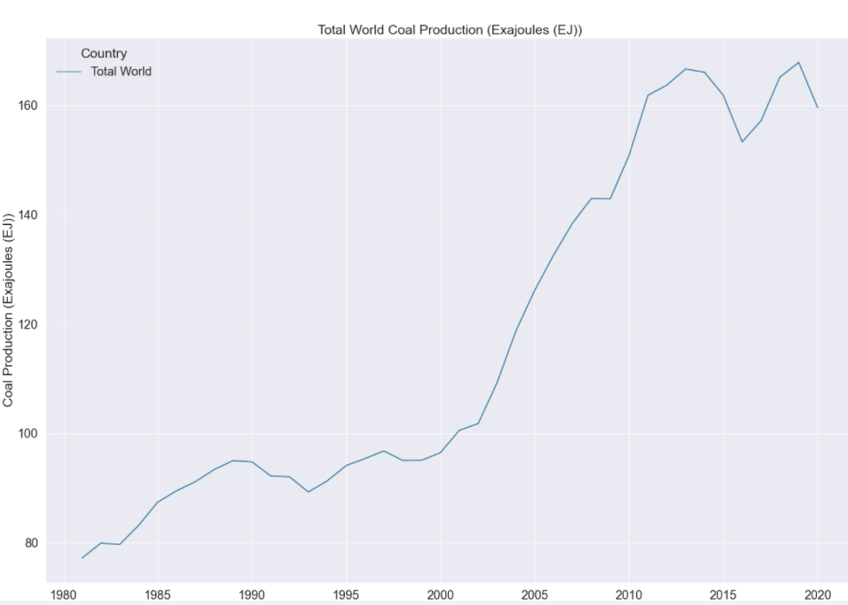
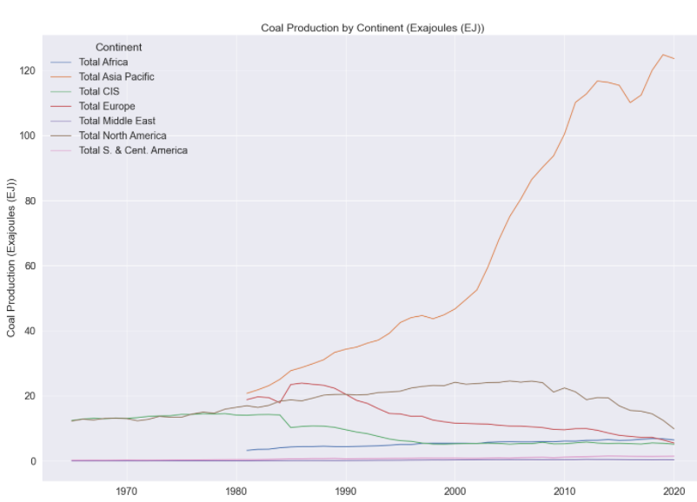
Coal Production: Total World and by Region
Notes:
Missing data before 1980 for Europe, Asia Pacific, and Africa. Trends are very similar to coal consumption.

Slide 10
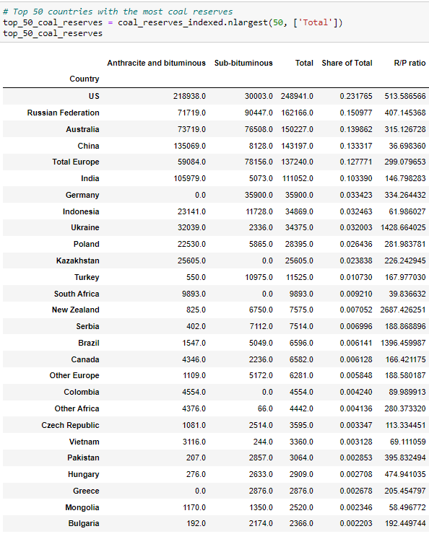
EDA: Coal Reserves

Slide 11
Oil
Facts:
If Asia were to catch up to U.S. diesel/oil consumption rates, the global production would 'have to rise by 300% per day'. It is because of diesel, fertilizer, and heavy equipment, farming yield rates increased 250% during the 1950s. Hence without oil, modern agriculture will not be able to feed the current world population. (Is The Earth Actually Running Out Of Oil? | The Struggle For Oil | Spark – YouTube)
A country with large amounts of reserves does not always translate to strong production numbers for petroleum, oil, and by-products. Oil reserves simply serve as an estimate of the amount of economically recoverable crude oil in a particular region. To qualify, these reserves must have the potential of being extracted under current technological constraints.
Notes:
So we’ll see later that Asia does surpass U.S. in oil/consumption rates, and this is a big issue since we would need a bigger increase in oil production to create a balance to fuel modern agriculture to feed the population.

Slide 12
EDA: Oil
MW
Top 6 Countries w/ highest MW: Azerbaijan, Taiwan, Japan, South Korea, Singapore
Oil Reserves
Top 5 countries w/ most oil reserves at end of 2020: Venezuela, Saudi Arabia, Canada, Iran, Iraq
Oil Production
US leads in oil production. Saudi Arabia in 2nd place and Russian Federation in 3rd place (along with former USSR)
Oil Consumption
US is 1st place, Total Europe in 2nd place.
Notes:
MW: countries that reported to have the most electricity generation using petroleum or oil as primary fuel.

Slide 13
EDA: Calculating RPR and PRR
Reserves-to-production ratio: (Mbbl/y of proven oil reserve)/(Mbbl/y of produced oil) = years of proven oil reserves.
Rate of Emptiness (%): Production-to-reserves ratio (sum of yearly thousand barrels, aka all- time reserve). If the ratio is below 50%, it will indicate that the country has increasing volume and increasing prices is possible.
Notes:
Mbbl/y (barrels/year)

Slide 14
EDA: RPR and PRR Results
RPR: Years left of proven oil reserves for Venezuela, Saudi Arabia, and Canada respectively: 1,540; 74; 90.
PRR: Approximate & of emptiness for Venezuela, Saudi Arabia, and Canada respectively: 15.3; 36.3; 23.6.

Slide 15
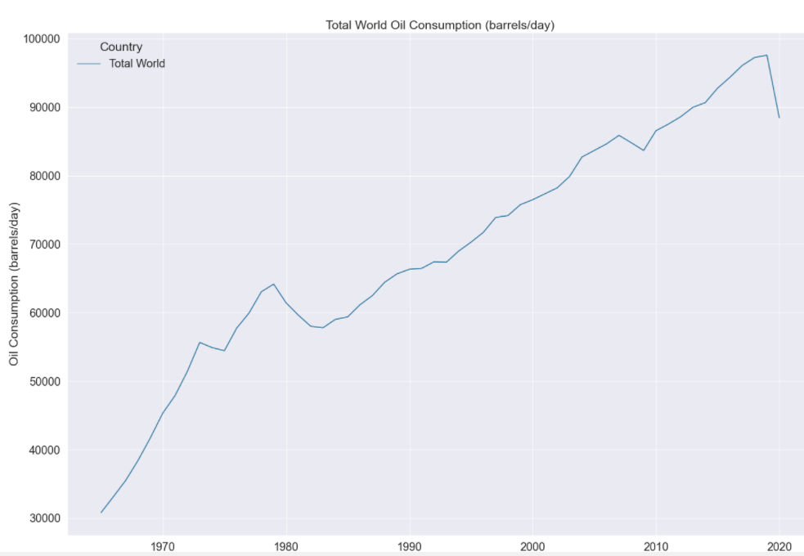
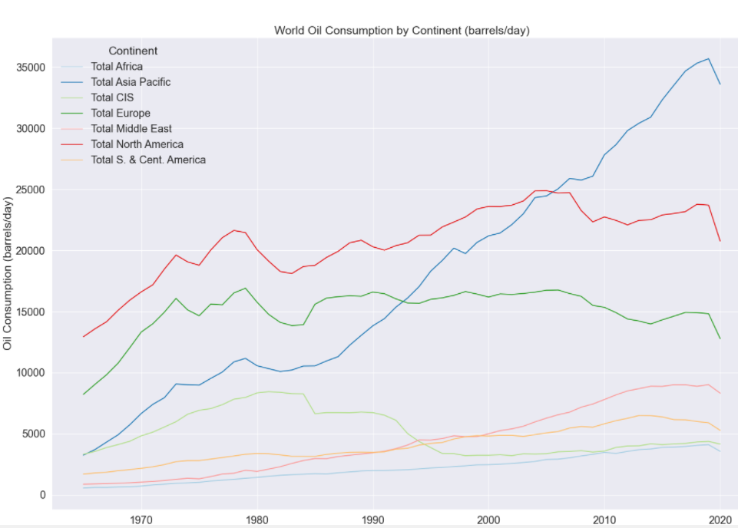
Oil Consumption: Total World and by Region
Notes:
In total world, there’s a mania phase between 1960 to 1973 when oil consumption has a steep incline. There’s a decline around 1973, possibly the 1973 oil crisis, and another decline around 1979, possibly the 1979 oil crisis. There recovery phase happens around 1984, then oil consumption gradually increases, with a peak loss seen around 2019, possibly due to the COVID19 pandemic. Trends are almost similar for by region, especially for Asia Pacific. However, there is a decline seen in oil consumption in 2007-2008 for North America and Europe, with North America recovering around 2009 and Europe not until around 2015.

Slide 16
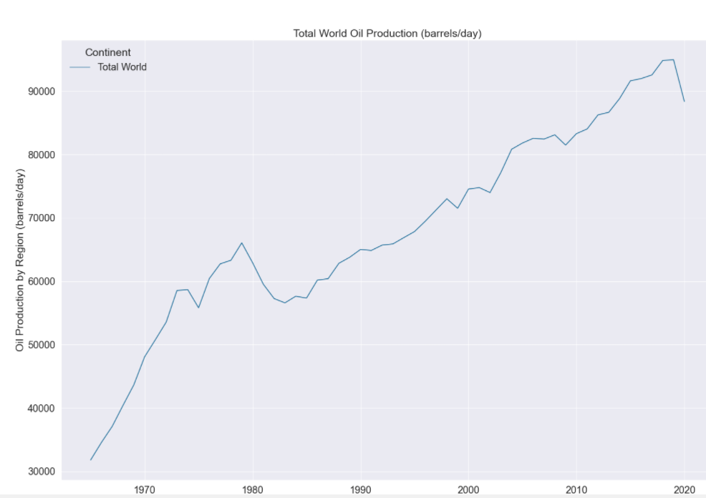
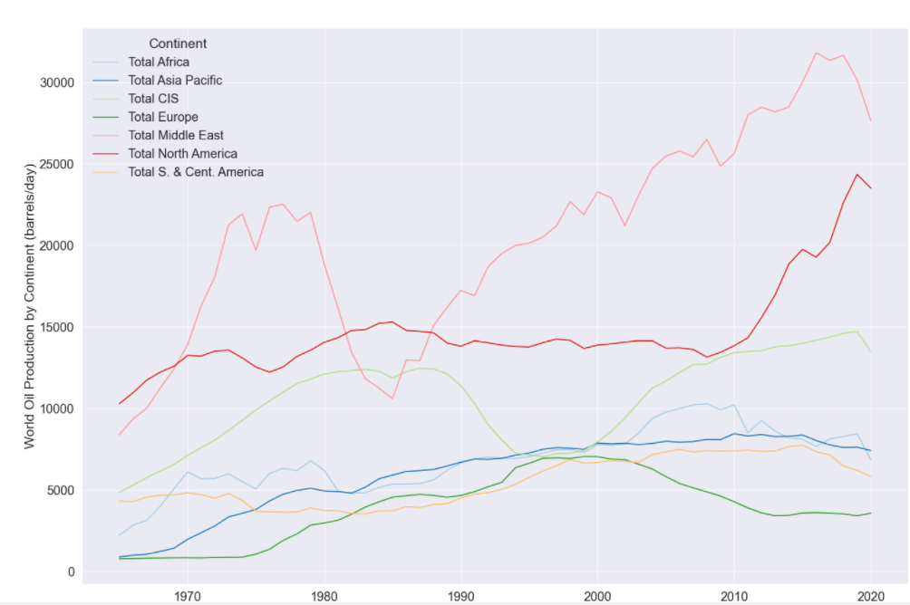
Oil Production: Total World and by Region

Slide 17
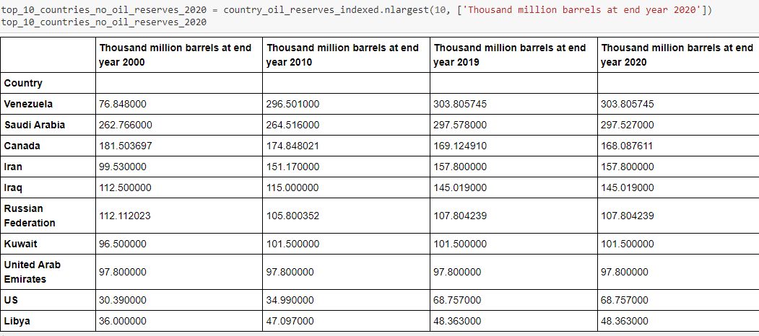
EDA: Oil Proved Reserves

Slide 18
EDA: Natural Gas
Capactiy MW
Top 6 Countries w/ highest capacity energy: Yemen, Vietnam, Venezeula, Uzbekiastan, U.S.
Gas Reserves
Top 5 countries w/ most oil reserves at end of 2020: Russian Federation, Iran, Qatar, Turkmenistan, U.S.
Gas Production
US leads in gas production. Russian Federation in 2nd place.
Gas Consumption
US is 1st place, Russian Federation in 2nd place.
Notes:
MW: These are the countrieswith the highest natural gas-fired generation of energy.

Slide 19
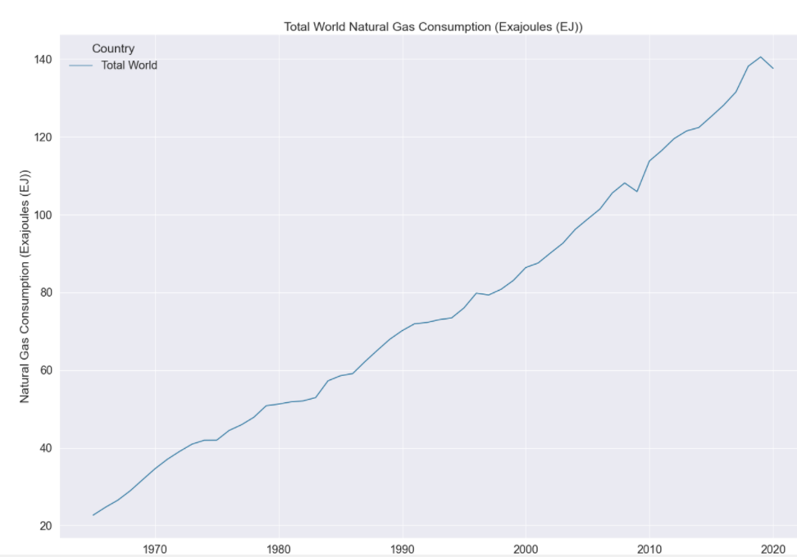
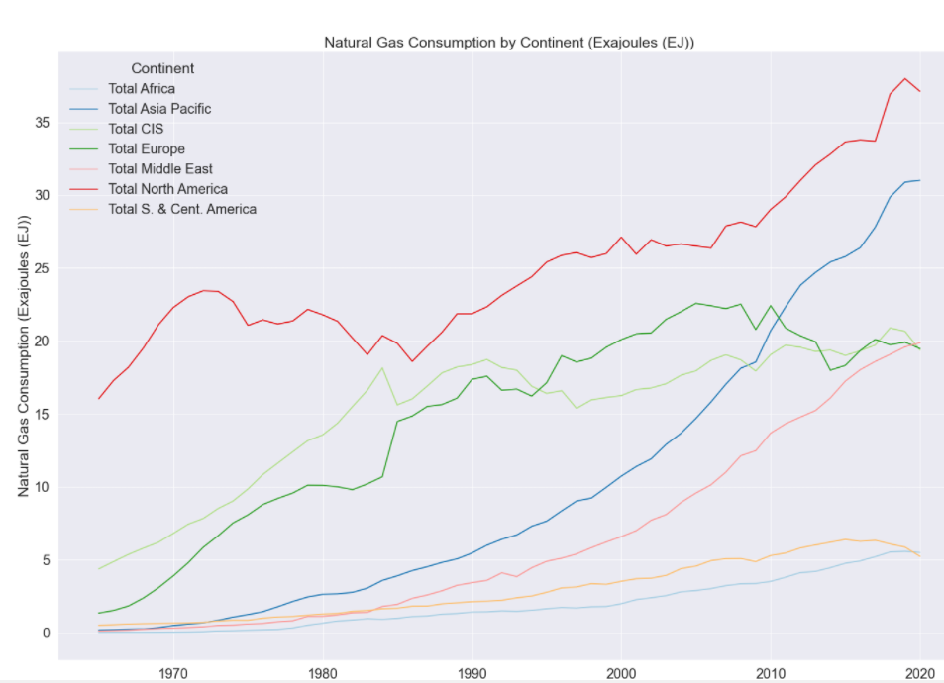
Gas Consumption: Total World and by Region

Slide 20
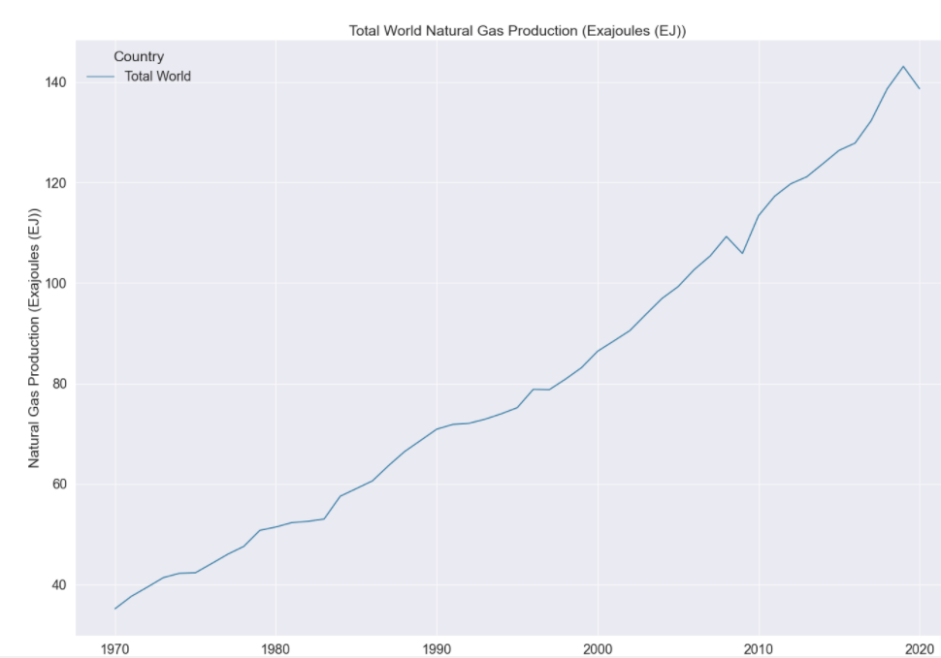
Gas Production: Total World

Slide 21
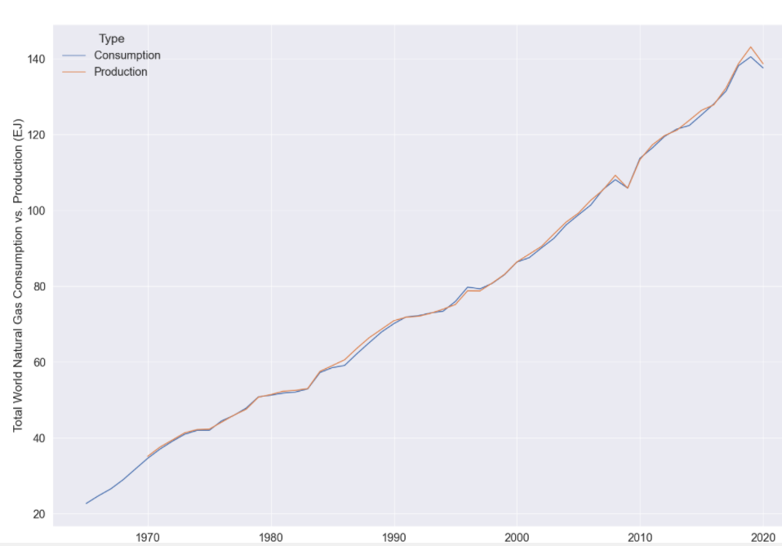
Gas: Total World Consumption vs. Production

Slide 22
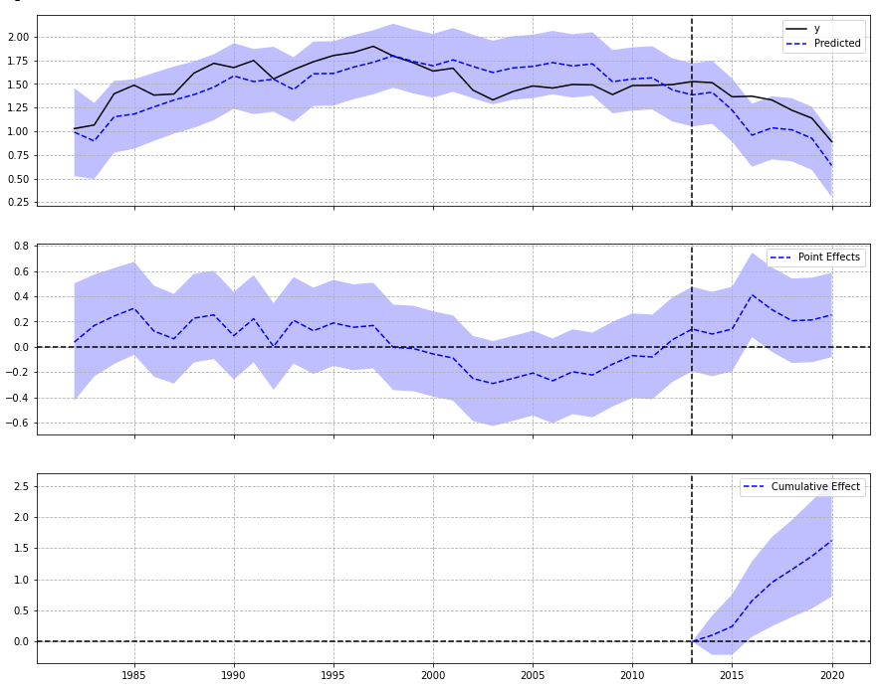
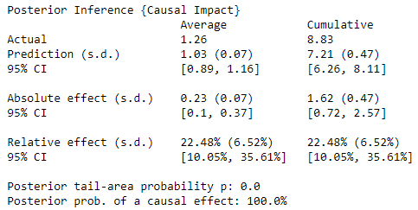
Synthetic Control: Coal Production
U.S.
Pre-period: 1981-2013 (83%)
Post-period: 2014-2020 (17%)
Notes:
Divided into 3 graphs: original at top, pointwise in middle, and cumulative at the bottom. We are mostly interested in the first graph, where the actual value y is our control group, in this case U.S., and the predicted or dotted line is the treatment group, or all of the countries except U.S. What this causalimpact model does is it estimates observed rate of other countries compared to U.S. Here I’ve fitted data from 1981-2013, or 32 years, for the pre-period, which is about 83% of the data, and fitted 7 years or 17% for the post-period. Summary report: avg. coal prod. Throughout the period is 1.26 Exaj. There was a rise of about 0.23 in production, with relative change of +22.48% without the intervention the expected av. Would be 1.03. The +22.48% change means there was a positive effect observed during the intervention period and statistically significant and highly unlikely due to random fluctuations; so its highly unlikely for the experimenter to receive a negative effect.

Slide 23
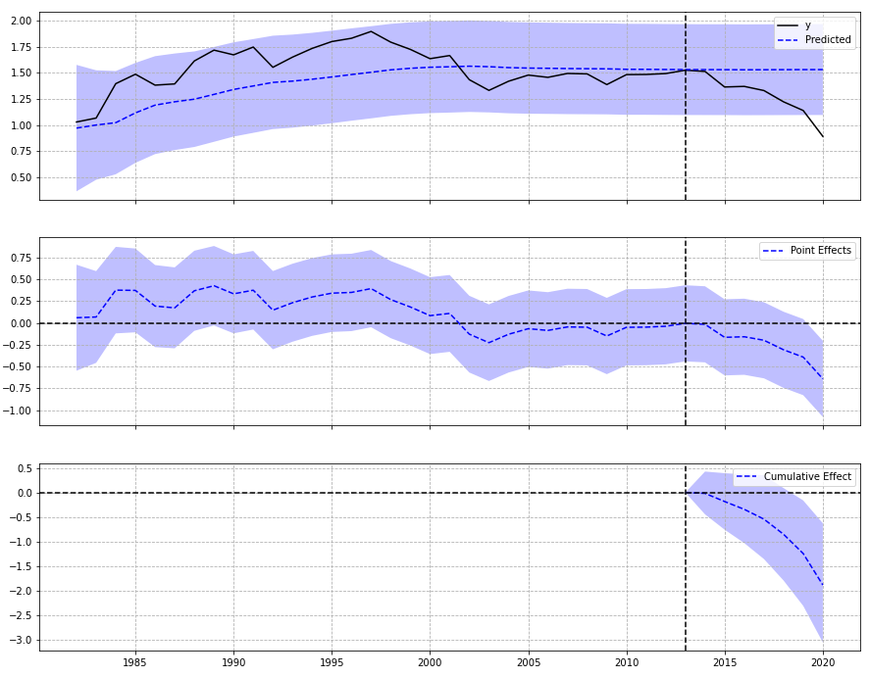
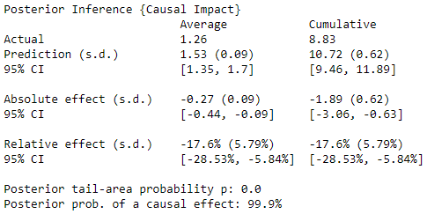
Synthetic Control: Coal Production
China
Pre-period: 1981-2013 (83%)
Post-period: 2014-2020 (17%)
Notes:
The actual average is also 1.26; however had the intervention not happened the av would be 1.53 EJ. Also, here there is a decline of 0.27 in production, with a relative change of -17.6%. So here the negative effect is statistically significant and if the experimenter receives a positive effect, it’s recommended they double-check for any anomalies in control variables.

Slide 24
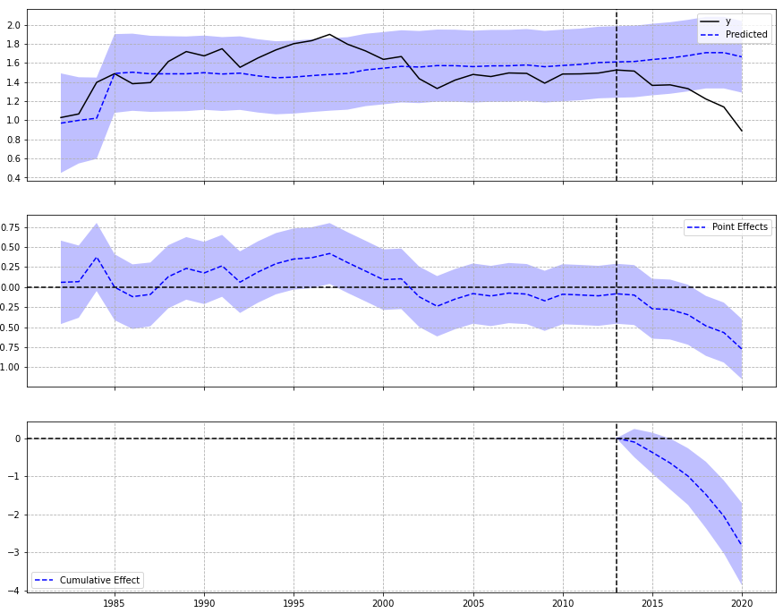
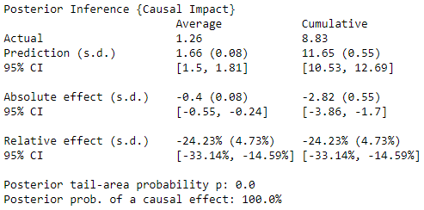
Synthetic Control: Coal Production
Russian Federation
Pre-period: 1981-2013 (83%)
Post-period: 2014-2020 (17%)

Slide 25
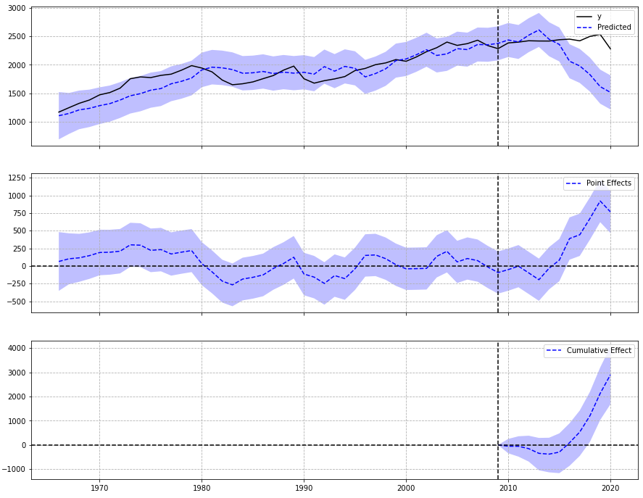
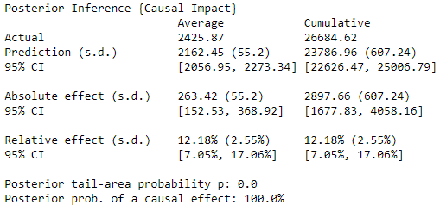
Synthetic Control: Oil Consumption
Venezuela
Pre-period: 1965-2009 (80%)
Post-period: 2010-2020 (20%)

Slide 26
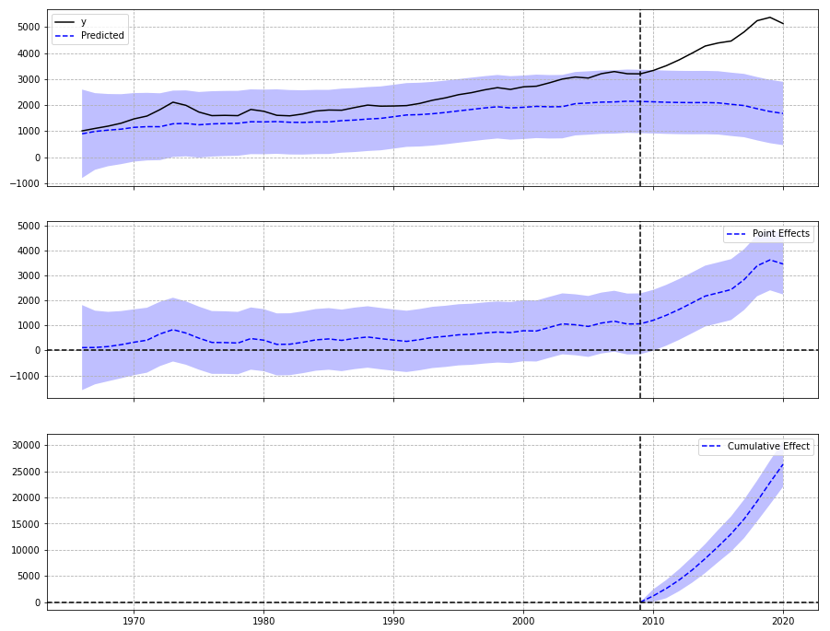
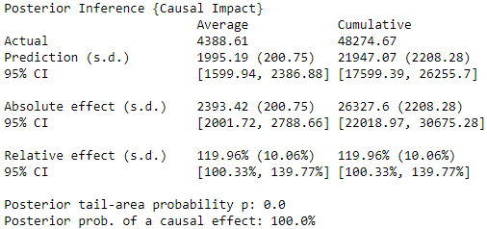
Synthetic Control: Oil Production
Venezuela
Pre-period: 1965-2009 (80%)
Post-period: 2010-2020 (20%)

Slide 27
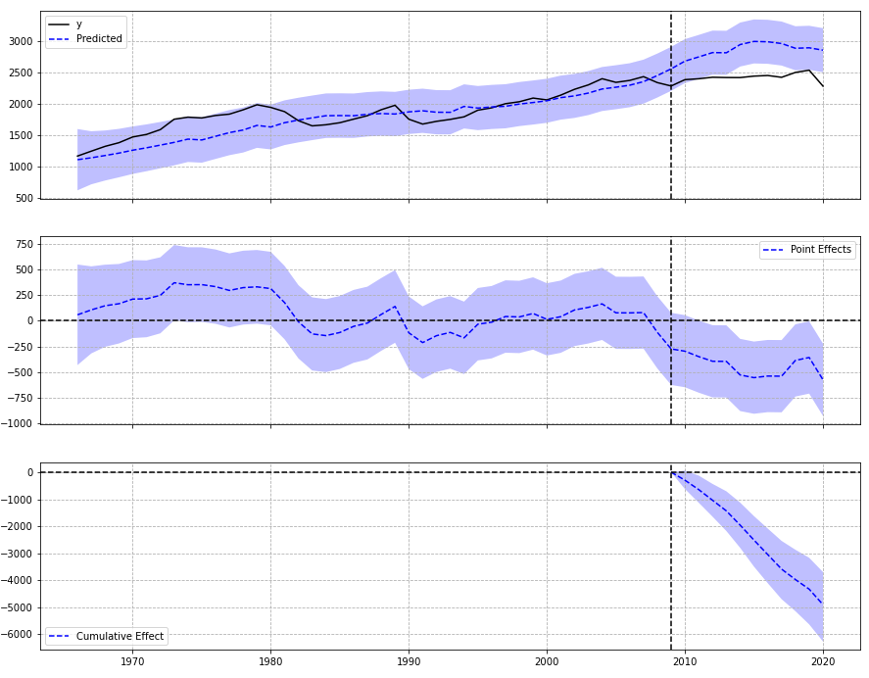
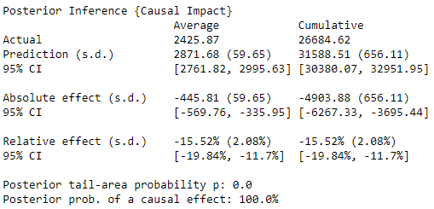
Synthetic Control: Oil Consumption
Saudi Arabia
Pre-period: 1965-2009 (80%)
Post-period: 2010-2020 (20%)

Slide 28
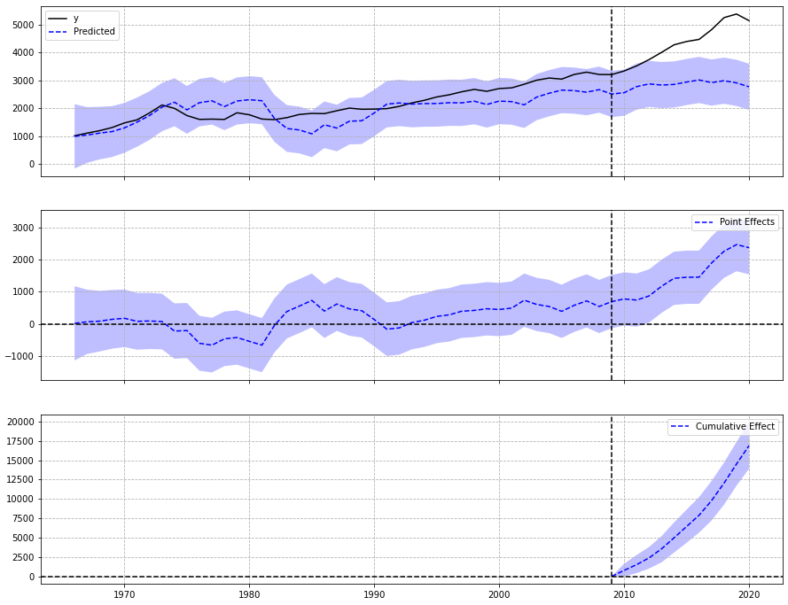
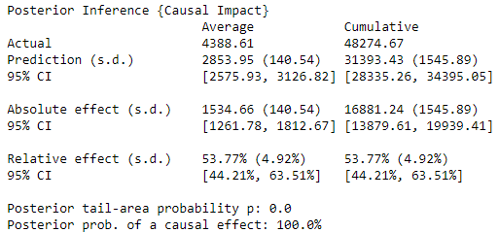
Synthetic Control: Oil Production
Saudi Arabia
Pre-period: 1965-2009 (80%)
Post-period: 2010-2020 (20%)

Slide 29
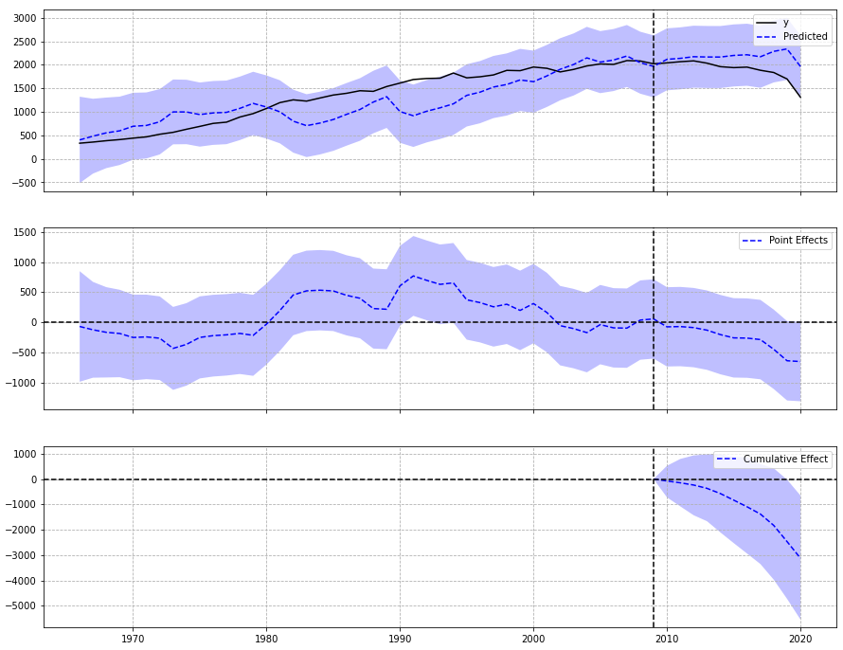
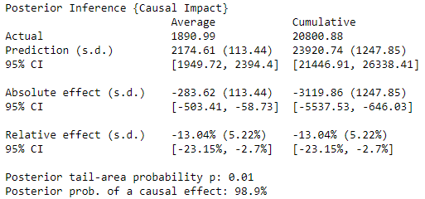
Synthetic Control: Oil Consumption
Canada
Pre-period: 1965-2009 (80%)
Post-period: 2010-2020 (20%)

Slide 30
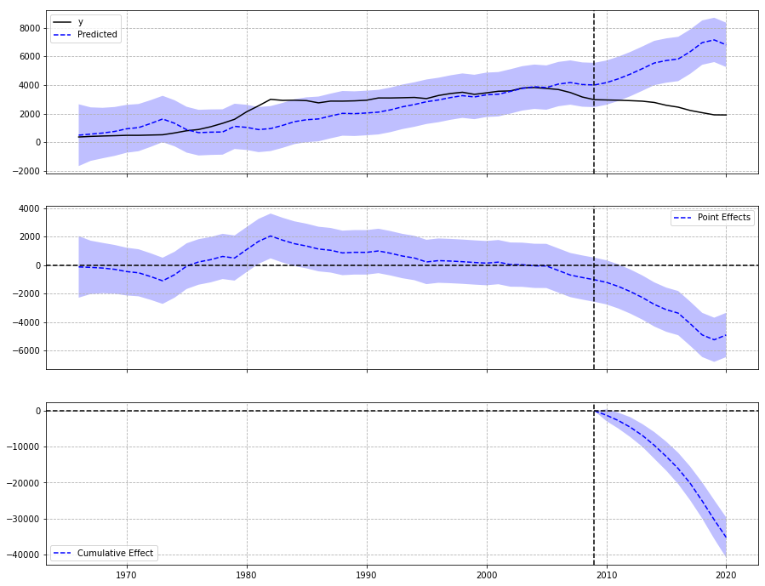
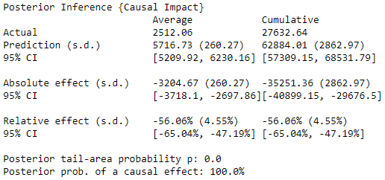
Synthetic Control: Oil Production
Canada
Pre-period: 1965-2009 (80%)
Post-period: 2010-2020 (20%)

Slide 31
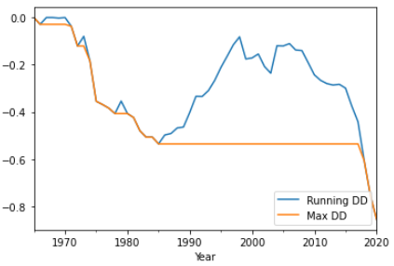
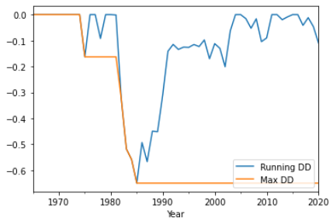
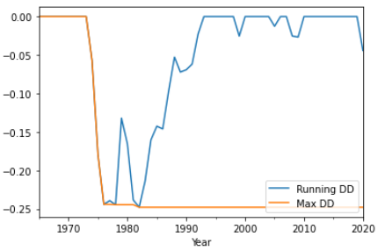
Max Drawdown: Oil Production
MDD is the maximum loss from a peak to a trough before a new peak is produced. One use of this is to measure a downside risk over a period of time
Venezuela
Saudi Arabia
Canada
Notes:
First drawdown observed: V: 1971 then 2nd in 1973; SA: 1975, 2nd 1983; CA: 1973.

Slide 32
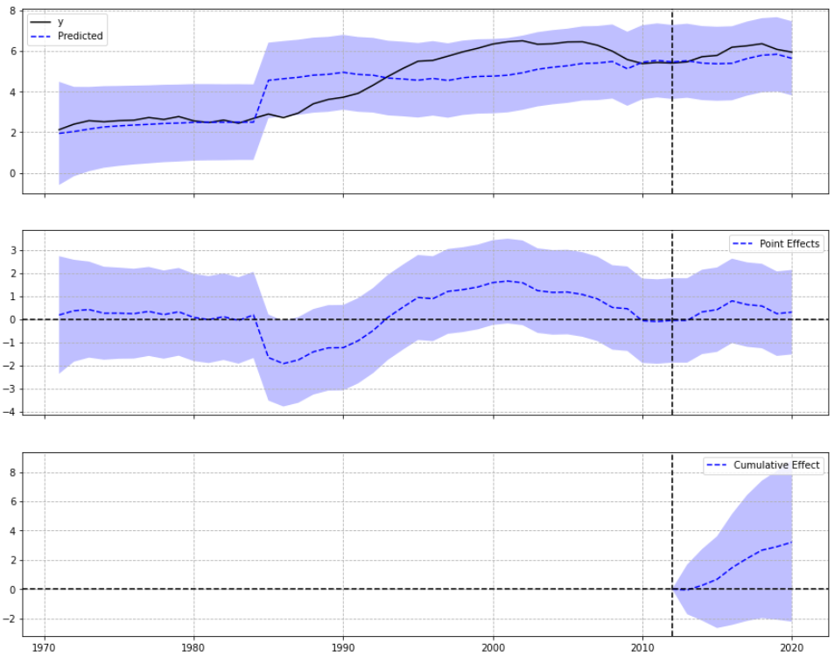
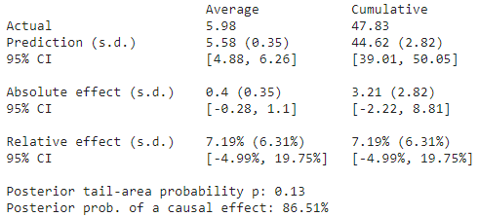
Synthetic Control: Gas Production
Russian Federation
Pre-period: 1970-2012 (84%)
Post-period: 2013-2020 (16%)

Slide 33
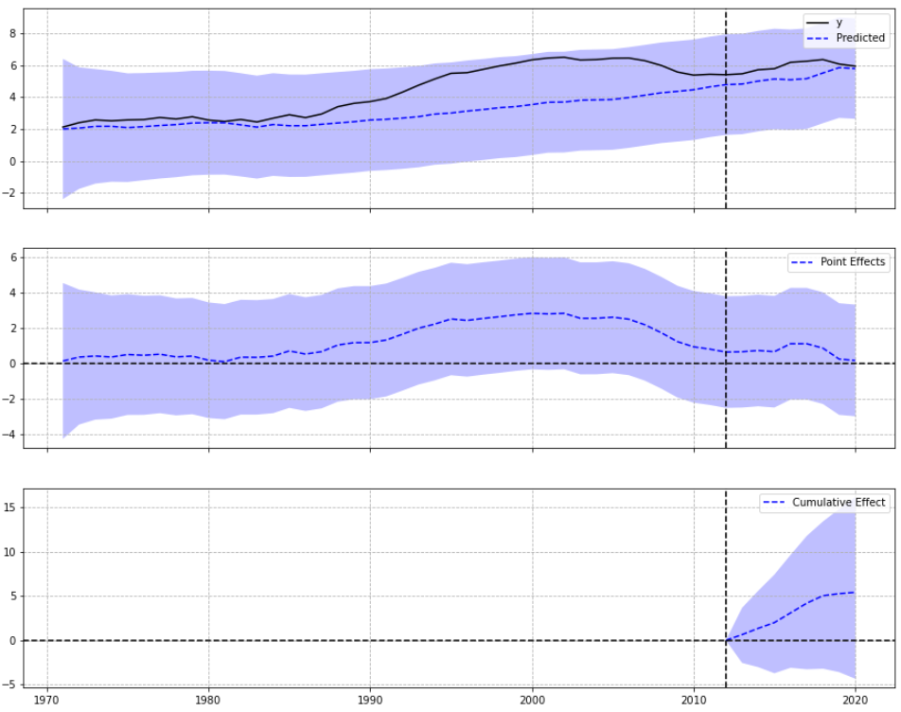
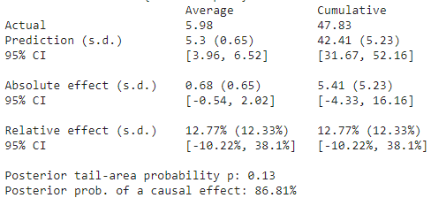
Synthetic Control: Gas Production
U.S.
Pre-period: 1970-2012 (84%)
Post-period: 2013-2020 (16%)

Slide 34
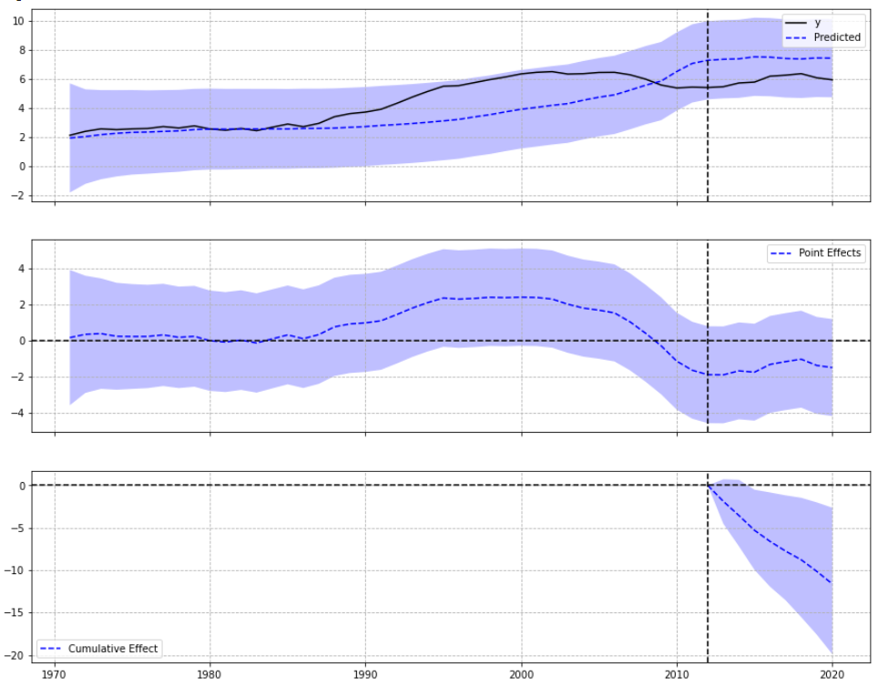
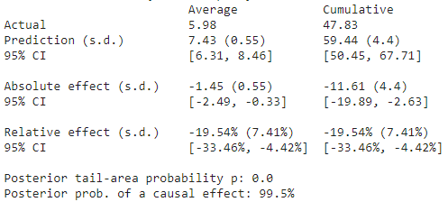
Synthetic Control: Gas Production
Qatar
Pre-period: 1970-2012 (84%)
Post-period: 2013-2020 (16%)

Slide 35
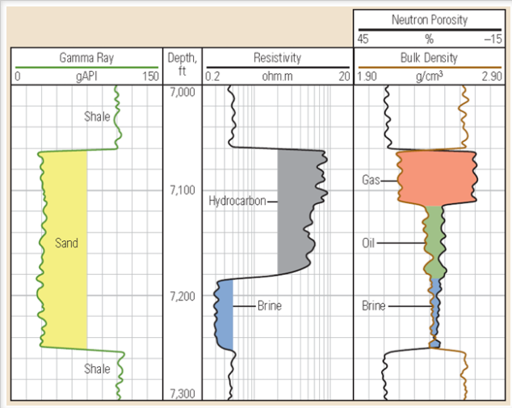
Well Log Analysis: Athabasca Oil Sands (Part 1)
Source: Athabasca Oil Sands Data McMurray/Wabiskaw Oil Sands Deposit - Electronic Data | Alberta Geological Survey (aer.ca)
Original file: 2,173 logs
Analyzed: 134 logs (no nulls)
Use Ko Ko Rules to analyze well logs:
De-spike and smooth well logs, as spikes are not true representative of rock properties variation through well intervals.
Plot triple combo logs sequentially: GR, Resistivity, Density-Neutron.
Plot GR in the first track and Resistivity in the second track.
Both curves should be plotted in increasing values from the left to the right.
Plot Density-Neutron together on the same track.
The values should be decreasing as we go from the left to the right.

Slide 36
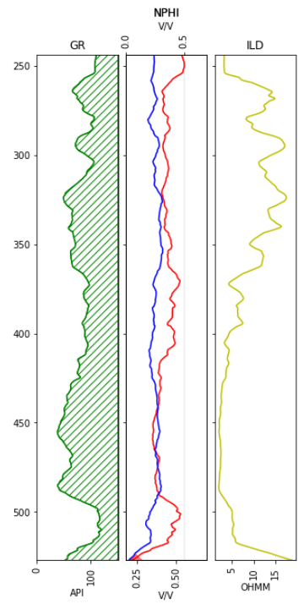
Well Log Analysis: Athabasca Oil Sands (Part 2)
Use Ko Ko Rules to analyze well logs:
Tight non-reservoir: Right-Right-Right-Right
Shale: Right-Right-Right-Left
Low porosity reservoir: Left-Right-Right-Right
Water-bearing reservoir: Left-Left-Left-Left
Oil-bearing reservoir: Left-Right-Left-Left
Gas-bearing reservoir: Left-Right-Left-Right
Goal: Create learning models to reduce the uncertainty and risk for drilling a dry well.

Slide 37
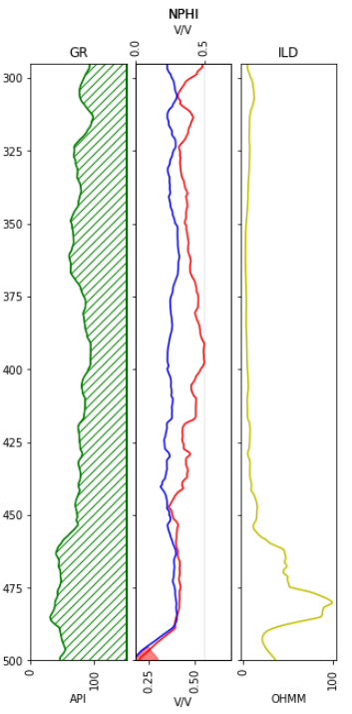
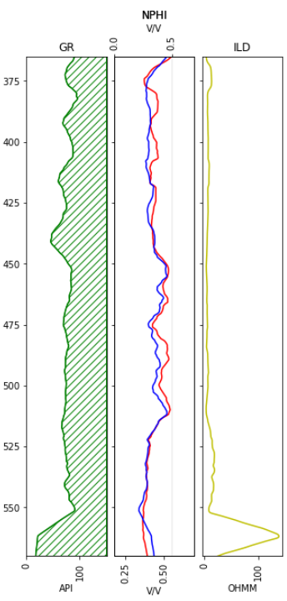
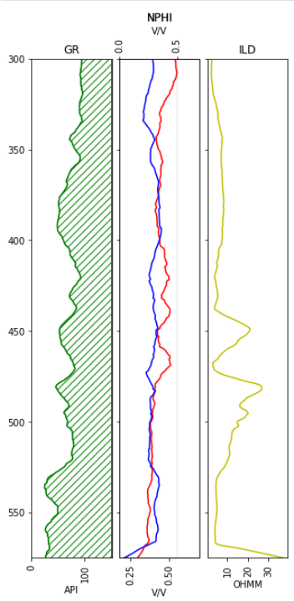
No
Yes
Yes

Slide 38
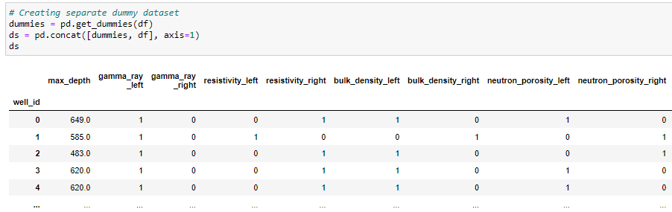
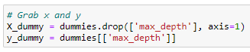

Feature Engineering: Regression Dataset
OneHot Encoding
Train and test split

Slide 39


Feature Engineering: Binary Classification Dataset
OneHot Encoding
Train and test split

Slide 40

Sklearn: Classification models
SVM model, Random Forest, Gini model, and GradientBoost
Support: No. of occurrences of each class in ground truth, target values.
Precision ratio: tp/(tp+fp)
Recall ratio: tp/(tp+fn)
F1-score: weighted mean of precision and recall; best at 1 worst at 0.

Slide 41







Classification Models: Scores and Feature Importances
Random Forest
GradientBoost
XGBoost

Slide 42


Classification Models: Pycaret
Notes:
Picked models with highest accuracy, auc, precision, and f1 scores, and also the ones that fit best with my data. KNN is good because it’s easy to implement, memory-based and adapts to new training data, and also applicable to multi-class problems, so it’s useful for regression problems as well. XGBoost implemented earlier produced excelled recall, accuracy, and precision scores (94-95%). XGBoost is an extreme gradient boosting that can detect and learn from non-linear data patterns, includes various regularization penalties to produce successful training for better generalization and avoid overfitting as well. And random forest, a parallel ensemble method also works well with non-linear data, less likely to overfit data, and has higher accuracy than other classifiers.

Slide 43



Classification Models: Pycaret – Create model

Slide 44



Classification Models: Pycaret – Tuning model

Slide 45



Classification Models: Pycaret – Evaluate model, Class prediction

Slide 46



Classification Models: Pycaret – Evaluate model, Learning Curve
Notes:
Here are plots for the learning curves, which displays the efficiency and the way the model learns. The blue represents training set and the green is the test set or CV. On the x axis is the number of observations or instances and on the y axis is the score. So for all models, we see that the models improve when more instances are introduced. Our goal here is to choose a model that learns the best and find the optimum model complexity where total error is low and variance and bias is relatively low. RF: there’s a difference btw training score and CV score, with CV score actually going down with more instances; we can say the model predicts the dataset with around 87-92% accuracy. XGB: the CV score fluctuates but stays between 85%-90% accuracy after 60 training instances; however there is still a difference between training score and CV score. KNN: the training score and CV score both increase with more instances, and the difference btw them is less than the other models, but the model does not reach 100% accuracy by 100 training instances and only has an overall accuracy score of around 86% after 60 training instances.

Slide 47




Classification Models: Pycaret – Interpret model
Notes:
Reason plot at observation level; The SHAP value, or Shapley Additive exPlanations is a game theoretic approach to explain the output of ML models. We can see the shapo values and how the features are influencing the classification output, this is applied to each row of data in the training set, and can be used to observe row-level and higher-level behaviors of certain features. SHAP values are calculated for each feature, for each value present, and approximate the contribution towards the output given by that data point. It’s worth noting, that the same values of a feature can contribute different amounts towards an output, depending on the other feature values for that row. Base: mean of output; the pink shows features being pushed in a positive direction, ordered by impact, and highest impact being resistivity for RF and XGBoost.

Slide 48



Sklearn: Regression models
Linear regression: OLS

Slide 49



Sklearn: Regression models
Decision Tree Regressor

Slide 50
Answering Questions
What possible effects (direct or indirect) does industrialization, modernization, and manufacturing have on the availability and distribution of coal, oil, and natural gas?:
As visualized in the line graphs and maximum drawdowns, there is a large loss from a peak around 1970s. This may be due to the 1973 oil crisis, when members of the Org. of Arab Petroleum Exporting Countries led by Saudi Arabia proclaimed an oil embargo. The embargo was targeted at nations that supported Israel during the Yom Kippur War. By the end of the embargo, price of oil rose nearly 300%. A second ‘oil shock’ occurred in 1979, caused by a drop in oil production in the wake of the Iranian Revolution.
On another note, the drop in oil consumption and production in Canada starting around 2008-2009 may be an affect of an increase in political initiatives in green energy. This can also be seen in coal production and consumption of U.S., China, and Russia.

Slide 51
Answering Questions
2. If and when will these resources be depleted?
China is the biggest producer and consumer of coal; however, there seems to be a recent downward trend. U.S. and Russia lead in gas production and consumption, with Russia having the more gas proven reserves. In both countries, trends are slowly increasing. Our RPR (90 years) and PRR (23.6% empty) for Canada seem to be good estimations for when oil reserves will be depleted. From the well analysis of Athabasca Oil Sands, our prediction is that depths of around 300-500m hold hydrocarbons.

Slide 52
Assumptions and Limitations
Only 6% of the data from Athabasca Oil sands well log was analyzed in this project. Analysis needs to be continued in the future.
More sources needs to be gathered for coal and natural gas for further analysis.
Unclear whether a constant was used for Regression Analysis in Pycaret (it was assumed no constant due to negative R2 scores). Hence, regression models from Pycaret was not used for project conclusions.

Slide 53

The End
Github: Personal-Capstone-Projects/Estimating when four natural resources will be depleted at main · yuvemaq/Personal-Capstone-Projects (github.com)
Linkedin: (26) Yvonne Mae Quiachon | LinkedIn

